Slide 1
Data Redundancy Removal System
System Overview
This system is designed to identify, classify, and prevent redundant data from entering a cloud database while ensuring only unique, verified data is stored

Slide 2
Core Components
Data Ingestion Layer
Input Validation: Basic format and type checking
Data Normalization: Standardizes data formats (dates, phone numbers, etc.) Temporary Storage: Holds incoming data for verification
2) Redundancy Detection Engine
function checkForRedundancy(newData, existingData) { // Implement similarity thresholds and matching algorithms // Return classification: unique, redundant, or potential false positive }
3) Validation Mechanism
Exact Matching: Direct comparison of field values
Fuzzy Matching: For text fields with potential typos or variations
Semantic Analysis: For more complex data relationships

Slide 3
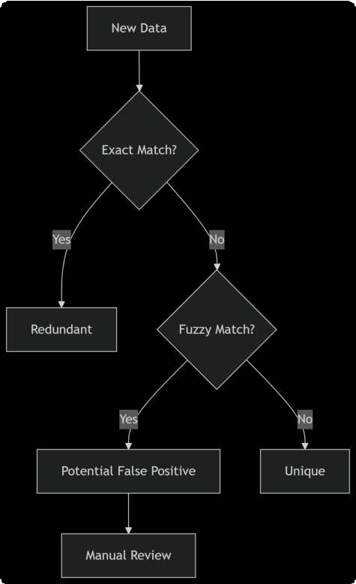
4) . Classification System
E --> G[Manual Review]
D -->|No| F[Unique]
D -->|Yes| E[Potential False Positive]
B -->|No| D{Fuzzy Match?}
B -->|Yes| C[Redundant]
A[New Data] --> B{Exact Match?} graph TD

Slide 4
5) Database Interface
Unique Data Appender: Only writes verified unique data
Redundancy Logging: Tracks detected duplicates for analytics
Implementation Detail
1)Similarity Detection Algorithm
.Exact Matching (for deterministic data)
.Levenshtein Distance (for text similarity)
.Cosine Similarity (for vector-based comparisons)
.Field-specific comparators (for specialized data types)

Slide 5
2) Database Schema Enhancement
CREATE TABLE data_entries (
id UUID PRIMARY KEY,
content_hash VARCHAR( ) UNIQUE, -- Cryptographic hash of normalized content JSONB NOT NULL,
created_at TIMESTAMP DEFAULT NOW(),
verified BOOLEAN DEFAULT FALSE
);
CREATE TABLE redundancy_logs (
id SERIAL PRIMARY KEY,
incoming_data JSONB,
matched_entry_id UUID REFERENCES data_entries(id),
similarity_score FLOAT,
classification VARCHAR( ),
detected_at TIMESTAMP DEFAULT NOW()
);

Slide 6
Workflow Process
.Receive new data entry
.Normalize and hash the data
.Check against existing content hashes
.If no match, perform fuzzy comparison
Classify as unique, redundant, or potential false positive
.Take appropriate action based on classification

Slide 7
Optimization Techniques
.Bloom Filters: For quick preliminary uniqueness checks
.Indexed Hashing: Fast lookup of content hashes
.Batch Processing: For handling bulk data imports
.Caching: Store recent entries to avoid repeated database queries

Slide 8
False Positive Handling
.Manual Review Queue: For borderline case
.Machine Learning: Improve classification over time based on corrections
.Threshold Tuning: Adjust similarity thresholds per data type

Slide 9
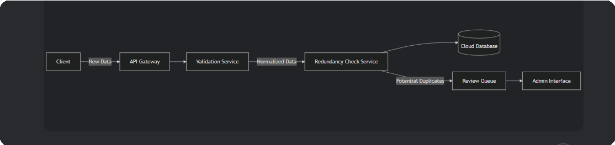
Deployment Architecture

Slide 10
Code
graph LR
Client -->|New Data| API[API Gateway]
API --> Validator[Validation Service]
Validator -->|Normalized Data| RedundancyChecker[Redundancy Check Service] RedundancyChecker --> DB[(Cloud Database)] RedundancyChecker -->|Potential Duplicates| ReviewQueue[Review Queue]
ReviewQueue --> AdminUI[Admin Interface]

Slide 11
Monitoring and Metrics
.Redundancy detection rate
.False positive/negative rates
.Processing latency
.Database storage savings

Slide 12
THANK YOU

